Slide 1

Green University of Bangladesh Department of Computer Science and Engineering(CSE)
Faculty of Sciences and Engineering Semester: (Fall , Year:2022), B.Sc. in CSE (Day)
LAB REPORT NO : 07
Course Title : Structured Programming Lab
Section : DC
Course Code : CSE 104
Student Details
Name | ID
Md. Sohan Millat Sakib | 222902036
: 07-12-2022
Lab Date Submission Date: 12-12-22 Course Teacher’s Name
: JARIN TASNIM TONVI
[For Teachers use only: Don’t Write Anything inside this box]
Marks:.....
Comments:
Lab Report Status
Signature: Date:.........

Slide 2
Problem 1:
Title: Write a recursive function to generate n^{th} Fibonacci term in C programming.
Objectives:
To be familiar with scanf and printf functions.
To be familiar with logical expression.
To be familiar with user-defined function.
To be familiar with Recursion.
Input & Output:
At first, the program input a number from the user. Then using fib(n-1)+fib(n-2) rule the program finds the nth number Fibonacci number.
Implementation:

Slide 3
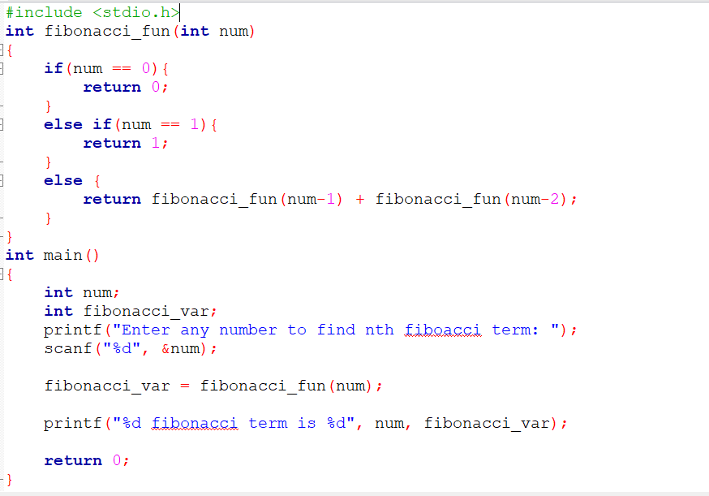
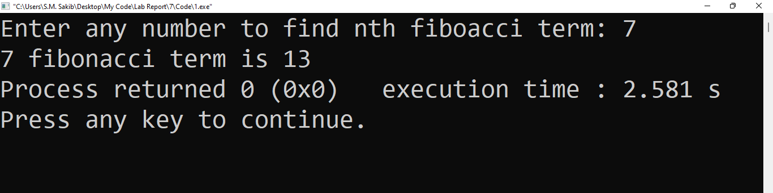
Test Result:

Slide 4
Discussion: When I write the program I have to learn about the rule of n^{th} number of Fibonacci numbers. And then Using Recursion I solve this problem.
Problem 2:
Title: Write a C program to calculate sum of all digits of a number using recursion.
Objectives:
To be familiar with scanf and printf functions.
To be familiar with if else conditions.
To be a familiar user-defined function.
To be familiar with Recursion.
Input & Output:
At first, the program read a number from the user. Then the program separates each number and then find out all number’s sumission using recursion.

Slide 5
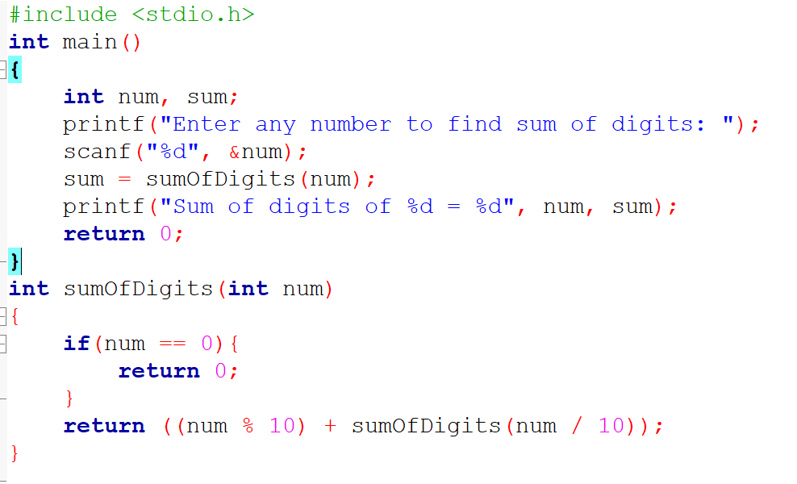
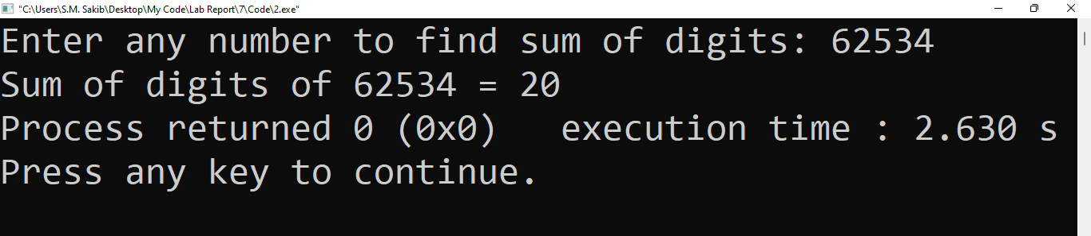
Implementation:
Test Result:
Discussion: When I solve the problem I don’t face any problem….

